Slide 1
The Power of Positive Connections:
Reducing Chronic Absence Through PEOPLE
(Priority Early Outreach for Positive Linkages and Engagement)
Attendance Works

Slide 2
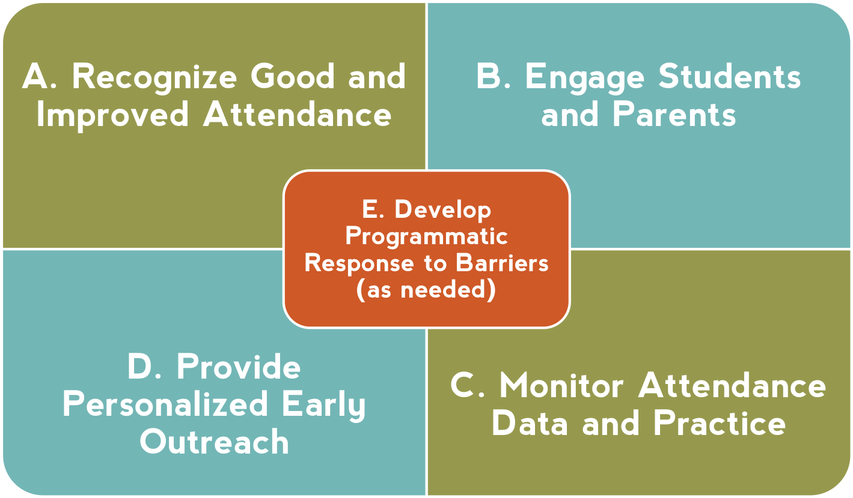
AW Recommended Site Level Strategies
Leverage Strategies C and D to Adopt the PEOPLE Strategy Starting at the Beginning of the School Year
Notes:
At same time, we know schools and communities can understand why kids aren’t in school and turn attendance around when they implement these five strategies with fidelity. How schools carry them out can be tailored to their own realities and strengths.
Then – I go through and offer examples of what each one of these might look like. I also clarify that recognizing good and improved attendance isn’t just providing perfect attendance awards for a semester or year– which doesn’t help to motivate improvement among the students with the most problematic attendance.

Slide 3
Priority Early Outreach for Positive Linkages and Engagement (PEOPLE)
Priority: Focuses on at-risk students in grades, schools and neighborhoods with high levels of chronic absence
Early: Begins with the start of school.
Outreach: Connects to students and families
Positive: Promotes preventive, supportive approaches rather than punitive responses
Linkages Taps the full community for support
Engagement: Motivates showing up to class & offers students & families a role in improving attendance.

Slide 4
Implementing PEOPLE
(Priority Early Outreach for Positive Linkages and Engagement)
1
Determine where to begin PEOPLE using a data-driven approach
Establish a team to implement PEOPLE
Examine which students need PEOPLE
Connect students and families to positive supports
Reflect and celebrate
5
2
4
3

Slide 5
Identifying Where To Begin Implementation
School Leadership
Low Income Students and High Levels of Chronic Absence
Supportive Community Partners
Identifies Priority Schools, Neighborhoods or Grades within School to Begin Implementation

Slide 6
Use Data to Identify Where To Begin Implementation Within a District or School
Proposed Criteria:
Significant number of low-income students
Elevated chronic absence rates especially in transitional grades (e.g. K/1, 6th, 9th grades)
School leadership committed to making attendance a priority and adopting recommended practices and working with priority outreach list
Community partners that can help support the work

Slide 7
When to Begin Tier 1
Summer
Tier 1:
Universal
Teacher Welcome:
Teacher contacts family to welcome them to school, remind them of 1st day, and invite to Back to School celebration
Back to School Celebration:
Backpack giveaway, announce attendance incentives gather families living in same area to talk about coordinating getting to school
Community Partner Welcome:
Staff member reminds family of first day of school, invites to community-led Back to School celebration(s)
Back to School Neighborhood or Community Rally
Tier 2:
Early Outreach
Tier 3:
Intensive Intervention

Slide 8
For Tier 1: Leverage Our
Communication Resources
Count Us In Toolkit: http://awareness.attendanceworks.org/resources/toolkit/
Bringing Attendance Home Parent Video: http://www.attendanceworks.org/tools/for-parents/bringing-attendance-home-video/
Bringing Attendance Home Toolkit: http://www.attendanceworks.org/tools/for-parents/bringing-attendance-home-toolkit/
Parent flyers: http://www.attendanceworks.org/tools/for-parents/

Slide 9
Criteria for Identifying Priority Students for Tier 2 Supports
Chronic absence (missed 10% or more of school) in the prior year, assuming data is available.
And/or during the beginning of the school year, student has:
In first 2 weeks
2 absences
In first month (4 weeks)
2-3 absences
In first 2 months (8 weeks)
4 absences

Slide 10
Students Who Miss 2 or More Days of School in The First Month of School Are Significantly More Likely to Be Chronically Absent by the End of the School Year
Percent chronically absent at the end of the school year
Baltimore students who missed 2-4 days of school in September were 5 times as likely to be chronically absent.
Students who missed 5 or more days of school in September were 16 times as likely to be chronically absent.

Slide 11
When to Begin Tier 2
1st Day of School
End of Week 1
Beg. of Week 2
End of Week 4
First Month
of School
Tier 1:
Universal
School-Designed Attendance Ritual
School-Designed Attendance Ritual
Community Partner-Designed Attendance Ritual
Tier 2:
Early Outreach
School Staff Check-In: Personal contact if students exhibits chronic absence Share something positive @ child , offer help with barriers & connect to positive supports.
Community Partner Staff Follow-Up: Staff follows up with families to help address barrier/offer support. Confidentiality agreement needed if data is shared.
Tier 3:
Intensive Intervention
Needed Infrastructure Supports and Training
Attendance Team Meeting:
Include key community partner staff; decide which families need home visit and who will conduct it

Slide 12
Possible Tier 2 Interventions
Recruit for engaging Before- or After-School Activities
Partner with families/students to develop Student Attendance Success Plan
Connect to Walk- to-School Companion
Assign Attendance Buddies
Positive Linkages and Engagement for Students and Families
Offer plan or contacts for Health Support

Slide 13
PEOPLE Supports A Cost Effective Tiered Approach to Improving Educational Outcomes
TIER 3
Students who missed 20% or more of the prior school year (severe chronic absence)
Intensive case management with coordination of public agency and legal response as needed
High Cost
Provide personalized early outreach
Meet with student/family to develop plan
Offer attendance Mentor/Buddy
TIER 2
Students exhibiting chronic absence (missing 10%)
TIER 1
All students at priority schools
Recognize good and improved attendance
Educate & engage students and families
Monitor attendance data
Clarify attendance expectations and goals
Establish positive and engaging school climate
Low Cost
Notes:
Improving attendance requires a 3 tiered approach. The challenge is that too many schools and communities are failing to invest in the first two tiers of universal and preventative. The strategies we just outlined– help to ensure an investment in the bottom two tiers – recognizing good and improved attendance as well as parent and student engagement are part of universal approaches. Personalized early outreach ensures intervention happens early. Investing in these bottom tiers is both more effective and less costly. And, if schools don’t, then the top of the pyramid becomes easily becomes overwhelmed.

Slide 14
Who Can Help Advance a
PEOPLE Approach?
District Leaders
Offer district support and data
Identify and engage priority schools
PEOPLE
School Leaders
Make attendance a priority
Ensure implementation team and plan
Community Partners
Call for PEOPLE approach
Link to community resources (health, afterschool, food, mentoring, family support, etc.)

